Slide 1


Voice Intercom Manual
Easy the IP-based video transmission
Kiloview Electronics Co., Ltd.

Slide 2
Easy the IP-based video transmission
Instructions
Content
1
3
2
Operation steps
2-1: Device to device
2-2: Device to Web
2-3: Multi party call

Slide 3

Instructions
Easy the IP-based video transmission
Instructions
Kiloview voice intercom solution not only supports point to point voice communication, but also point to multipoint voice communication, the point could be PC, cellphone or all Kiloview devices.
Any device can automatically discover other calling devices in the network and shows as a list. You can select a device in the list to establish a call with the other party at any time. Save the selection of the last call, and the call relationship can be automatically established even after the power is turned off and restarted.
It allows the Web UI (PC browser/mobile browser) to directly establish a call with the device.
Note:
1. For those undiscovered devices, it can be manually added to the intercom list for intercom;
2. Please update your product to the latest firmware version to acquire voice intercom function from our website: www.kiloview.com/en/support/download/
3.Voice intercom function in devices just support USB port earphone at present.

Slide 4
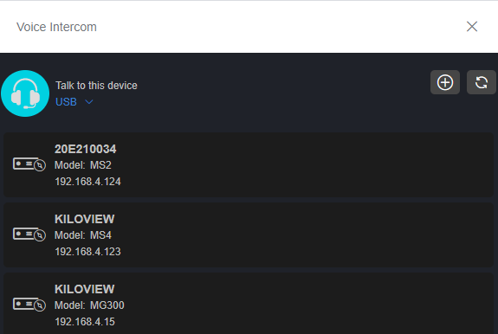
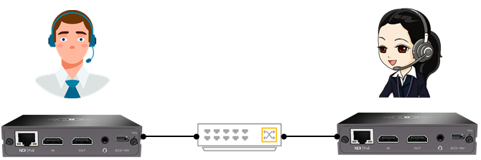
Operation steps
Easy the IP-based video transmission
Device to device
1.Through headset to realize device to device intercom. Each device can discover each other under the same subnet.
3

Slide 5
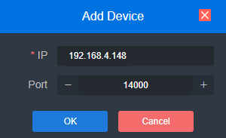
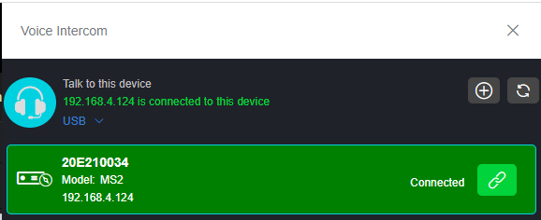
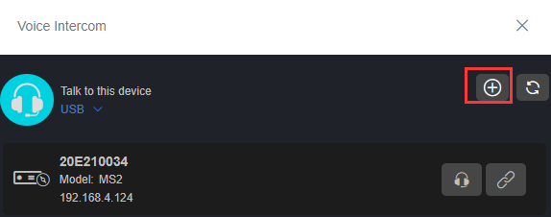
Operation steps
Easy the IP-based video transmission
Device to device
2. When two devices are on different subnet, click
to add the device and fill 14000 by default, cannot be modified.
3. Click the right icon on either end, and the device
starts to establish a connection. After connection,
it will display a green frame and start intercom.
3

Slide 6
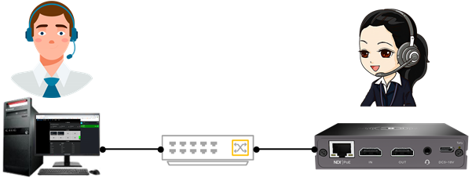
Operation steps
Easy the IP-based video transmission
Device to Web
1. Login to Web page and start intercom via your computer or phone. You can talk to the currently logged-in device, or you can set up talk to other devices.
3

Slide 7
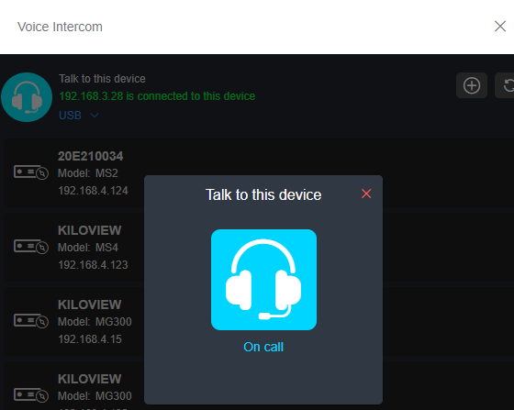
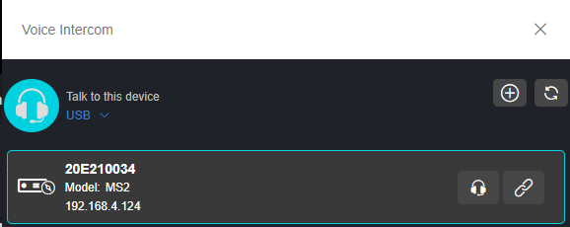
Operation steps
Easy the IP-based video transmission
3. Click headset icon, it starts to the call. After three beeps the call is established. The icon shows it is calling.
If using Web page for intercom, it needs to make sure the intercom page is always open, or the intercom disconnected.
Device to Web
2. On the Web page, click headset icon marked 1, it means talk with the current device.
If you click other devices’ icon on the list, it means talk with other device, such as the headset icon labeled 2.
3
1
2

Slide 8
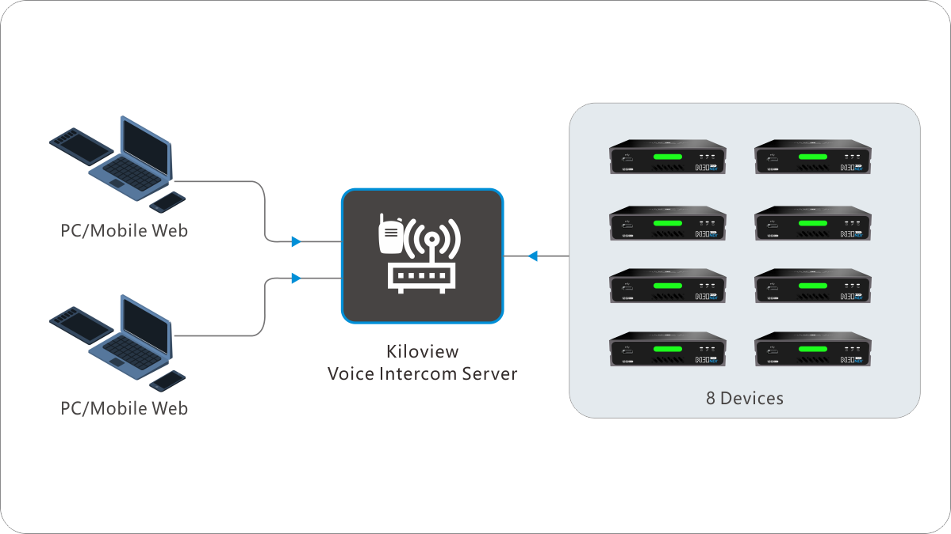
Operation steps
Easy the IP-based video transmission
Multi party intercom
Multi party intercom needs a Kiloview intercom server(hereafter referred to as KIS) to manage all Kiloview devices and PC/cellphone webpage users.
3

Slide 9
Operation steps
Easy the IP-based video transmission
Multi party intercom
KIS deployment
  Prepare a Linux+docker circumstance under x86-64 system;
  Login as administrator, run the command “docker run -d --restart always --name kvaudiosvr --privileged=true --net=host kiloview/kvaudiosvr”;
  Notes:
  Please visit https://server IP address to login the Kiloview intercom server , the username and password are admin by default;
  If browser get the tips “your connection is not private”, please click the “Advance” button, then click “continue to server IP(unsafe)”;
  If KIS deploy in public IP network, all ports need to be open.
3

Slide 10

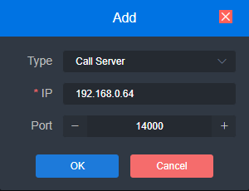
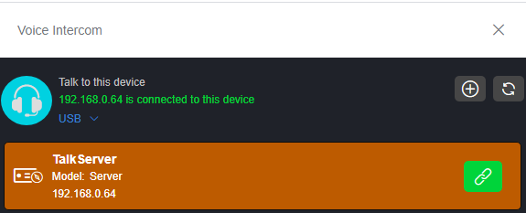
Operation steps
Easy the IP-based video transmission
Multi party intercom
2.Login to background of your device and start intercom via your computer.
4. Click below Talk Server, then the device starts to establish a connection to the Talk server. The Talk Server bar will be highlighted and will turn green.
There are 8 Kiloview devices could connect to the KIS simultaneously.
3. Click to select Type as Call Server, input the voice intercom server IP address, keep the default port 14000, then press OK button.
3

Slide 11
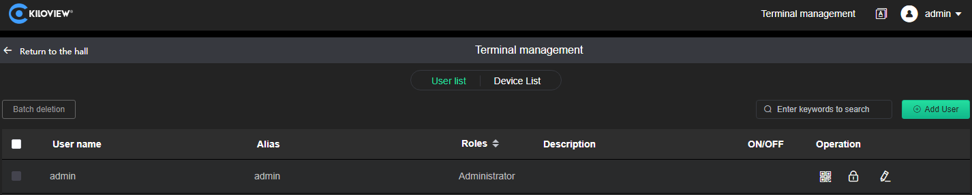
Operation steps
Easy the IP-based video transmission
Multi party intercom
5.Press Terminal management button on the top right, user could be added to manage the Talk Server, there are 2 PC/cellphone webpage users could login simultaneously. .
Return to the hall
User/Device list switch
Add webpage user
3
Modify user information
Batch delete users
Change password
Scan QR code by cellphone to join call

Slide 12
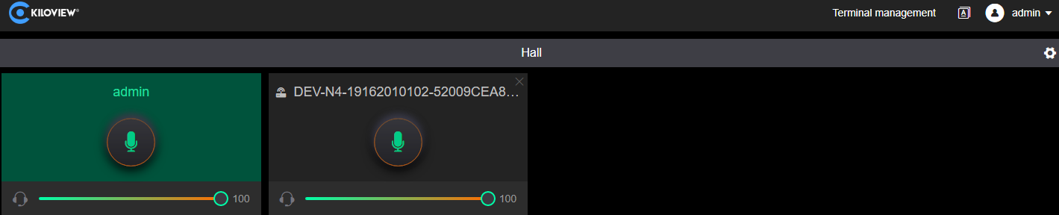
Operation steps
Easy the IP-based video transmission
Multi party intercom
6.Enter lobby to control the voice communication of all users.
Personal center/Change password/Logout
Voice switch
Volume bar
Language switch
3
3
All users voice switch

Slide 13


Any In Any Out Anywhere
KILOVIEW Electronics Co., Ltd.
Tel：86-731-8252-5732 E：info@kiloview.com Support：support@kiloview.com
Add: B4-106/109, Jiahua Intelligence Valley Industrial Park, 877 Huijin Road, Yuhua District, Changsha, China

