Slide 1


KILOVIEW Electronics CO., LTD.
Easy the IP-based video transmission
Leading innovator and solution provider of IP-based transmission

Slide 2
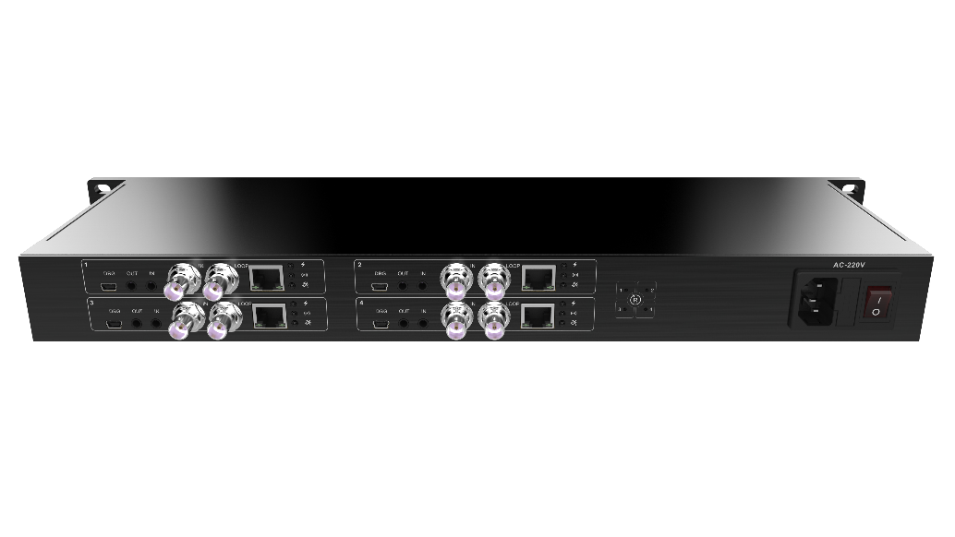
Products
Easy the IP-based video transmission
Kiloview Cradle Series ---Professional Rack Mounted Devices
The Kiloview Cradle series include 1RU or 3RU rack-mounted frame, freely mixed with 4 channels (1RU),16 channels/32 channels (3RU) codec modules. It comes with redundant power modules, centralized heat dissipation, ensuring longtime stable operation, and benefits your IP video deployments of any size and complexity.

Slide 3
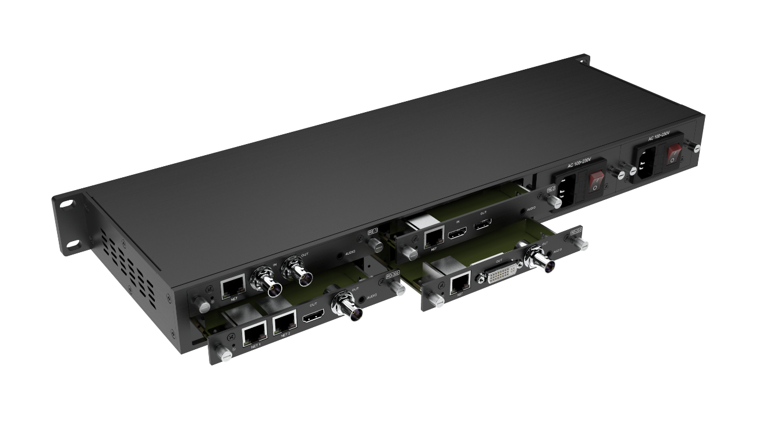
Products
Easy the IP-based video transmission
Kiloview Cradle Series ---Professional Rack Mounted Devices
Easy to use
Advantages：
High density
1. 4 encoder and decoder modules in a 1RU chassis, 16x or even 32x in a 3RU chassis;
2. Plug-in card structure, free mixing encoding and decoding cards, flexible application and replacement;
3. Standard dual power modules, dual cooling fan, stable and reliable operation;
4. Easy to use, mixing cards and easy to replace.
High reliability
High flexibility

Slide 4
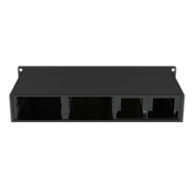
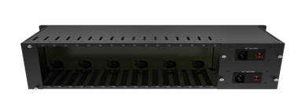
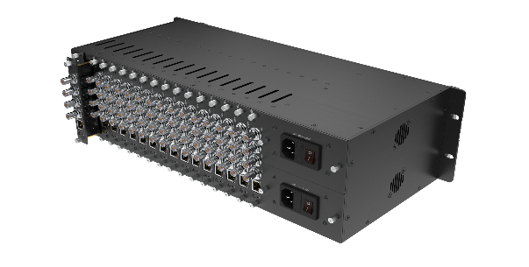
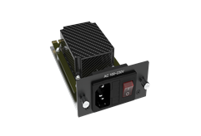
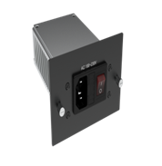
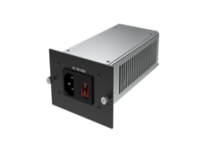
Products
Easy the IP-based video transmission
Kiloview Cradle Series ---Professional Rack-mounted devices
Model/components | 1RU (4CH) | 3RU (16CH) | 3RU (32CH)
Frame | RU01
Power adaptor (optional accessories) | PU01-35W for RU01 | PU03-110W for RU03 | PU03-300W for RU03S
RU03
RU03S
48.2x19.95x13.2cm
48.2x25.25x13.2cm

Slide 5
Products
Easy the IP-based video transmission
Encoding Card | RE-1 | RE-2 | REN-1 | REN-2 | RE-100 | REN-100
Video Interface | 1*BNC SDI | 1*HDMI | 1*BNC SDI | 1*HDMI | 2*BNC SDI | 2*BNC SDI
Video Loop | 1*BNC SDI | 1*HDMI | 1*BNC SDI | 1*HDMI | 2*BNC SDI | 2*BNC SDI
NDI|HX | N/A | N/A | NDI|HX 1.0 and 2.0 | NDI|HX 1.0 and 2.0 | N/A | NDI|HX 1.0 and 2.0
Video Encoding | H.264/AVC, Motion-JPEG
Audio Interface | 1*3.5mm Line in |  |  |  | N/A | N/A
Audio Encoding | AAC/G.711
Network | Ethernet
Image/Text Overlay | Custom defined text and picture overlay supported, which can be set to any position on the screen
Video Rotate/Crop | Supported
Resolution | Up to 1080P60Hz
Protocols Supported | SRT/RTMP/ RTMPS/HLS/TS over UDP/RTP/RTSP /Onvif
Management | Web
Applicable Frame | RU01/RU03/RU03S |  |  |  | RU03S | RU03S

Slide 6
Products
Easy the IP-based video transmission
Decoding Card | RD-230 | RD-300 | RMG-300
Video output | 1*3G- SDI+DVI (compatible HDMI1.4/DVI1.0/VGA) | 1*3G- SDI+1*HDMI | 1*3G- SDI+1*HDMI
Network | 1 * 100M/1000M RJ- 45 | 2 * 100M/1000M RJ-45 | 2 * 100M/1000M RJ-45
Video Decoding | H.264 | H.265/H.264 | H.265/H.264
Decoding Capacity | Up to 4 channels decoding (4*1080P30 or 2*1080P60 and below） | Up to 9 channels decoding (9*1080P30 or 8*1080P60) | Up to 9 channels decoding (9*1080P30 or 8*1080P60)
Protocols Supported | SRT/RTMP/RTMPS/RTMP Server/HLS/ TS over UDP/RTP/RTSP | NDI|HX2.0/SRT/RTMP/RTMPS/RTMP Server/ HLS/TS over UDP/RTP/RTSP | NDI|HX2.0/SRT/RTMP/RTMPS/RTMP Server/ HLS/TS over UDP/RTP/RTSP
Protocol conversion capability | N/A |  | 9 CH 1080P video conversion simultaneously
Audio Decoding | AAC/G.711
Audio Output | SDI/HDMI Embedded, or 3.5mm Analog Output
Video Preview | Supported
Image/Text Overlay | Supported
Management | Web
Applicable Frame | RU01/RU03/RU03S

Slide 7
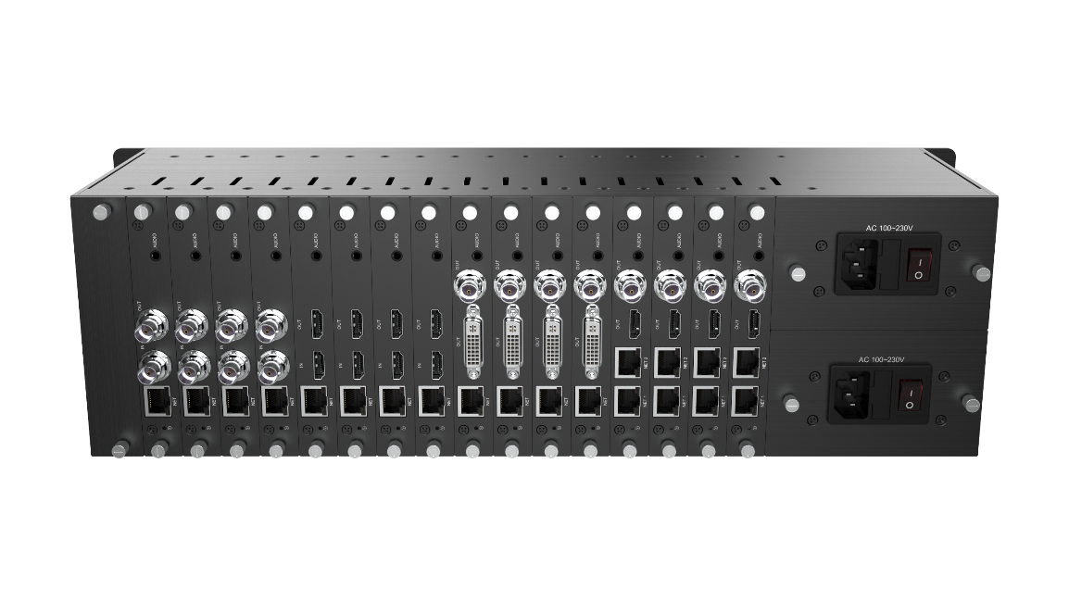

Products
Easy the IP-based video transmission
Kiloview Cradle Series ---Differences RU03 and RU03S
RU03-16CH
Similarities
1. Both are with16 cards slots
2. RU03S compatible with single input/output cards
Differences
RU03S-32CH
1. Power supply: RU03-110W, RU03S-300W;
2. RE-100 and REN-100 cards special for RU03S;
3. RU03 is for 16 channels single cards, while RU03S is for 16 channels dual cards/single cards;
4. Single cards including RE-1, RE-2, REN-1, REN-2, RD-230, RD-300, RMG-300 can be inserted into RU01, RU03 and RU03S; Only RE-100 and REN-100 cards are inserted into RU03S.

Slide 8


Any In Any Out Anywhere
KILOVIEW Electronics Co., Ltd.
Tel：86-731-88315979 E：info@kiloview.com Support：support@kiloview.com
Add: 188#, Middle Huanbao Rd., Yuhua District, Changsha, Hunan Province, China

